Slide 1
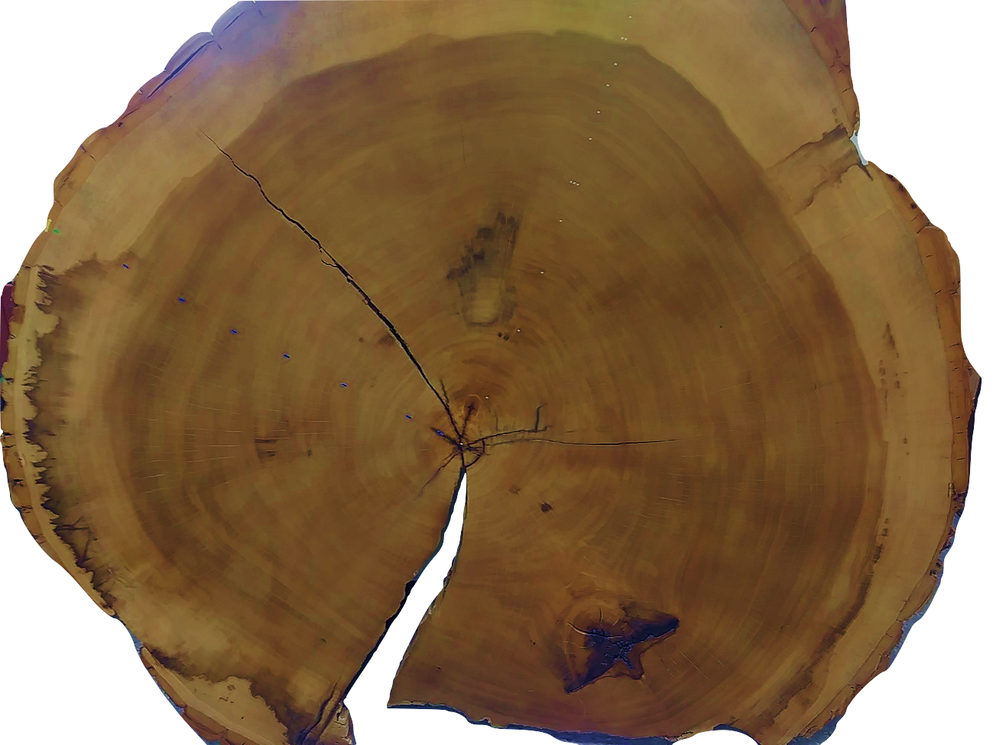

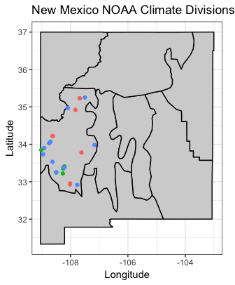




Modeling biological tree growth and climate simultaneously properly accounts for uncertainty and allows for flexible and explicit assumptions Reconstructions are highly dependent on assumptions of climate and climate-growth relationships
Non-Cognitive Predictors of Student Success: A Predictive Validity Comparison Between Domestic and International Students
Non-Cognitive Predictors of Student Success: A Predictive Validity Comparison Between Domestic and International Students
Hierarchical Bayesian models for climate reconstruction and uncertainty using tree-ring data
Daniel J. Hocking djhocking@frostburg.edu
Laura G. Smith lsmit224@vols.utk.edu
INTRODUCTION
Tree growth is a result of allometric growth patterns, climate, and non-climatic environmental conditions
Schofield et al. demonstrate a Bayesian, model-based approach to perform detrending and estimate climate-growth relationships simultaneously
Hiding Uncertainty: Traditional dendroclimatological reconstructions occur in steps with removal of the biological growth and non-climatic variation (noise) prior to regression with climate. Each step assumes 0 uncertainty in the steps preceding it
Flexible hierarchical framework: Easy to incorporate additional levels and variables such as species, site, disturbance, etc.
Bayesian inference: Credible intervals = more intuitive interpretation
Transparent, reproducible results!
METHODS
Temperature Reconstruction
Scotts Pine tree ring data from Tornetrask, Sweden
Precipitation Reconstruction
Multispecies from the NW Mountains Climate Region of NM (2902)
Mean Jan-Jul Climate Division Precip Data
Removed series not correlated to each other (Spearman $ρ<0.4$)
Removed series not correlated climate ($ρ<0.4)$
N = 929 series from 553 trees of 3 species (PIED, PIPO, PSME)
Run Bayesian models using JAGS in R
Details for the overly engaged
$log(rwl_{ikt})=α_{0ik}+α_{1ik}age_{ikt}+η_{t}+δ_{i}log(rwl_{ikt−1})+ε_{ikt}$
$$ε_{ikt}∼𝒩(0,σ_{i}^{2})$$
$$η_{t}∼𝒩(β_{k}climate_{t},σ_{kη}^{2})$$
$${climate}_{t}∼𝒩(μ_{x},σ_{x}^{2})$$
$$α_{0ik}∼𝒩(μ_{α_{0}k},σ_{α_{k}}^{2})$$
Ring Width = Biological Growth x Climate Response x Error
$$log(rwl_{ikt})=α_{0ik}+α_{1ik}age_{ikt}+β_{k}climate_{t}+ε_{ikt}$$
Detrending | Climate | Climate Relationship | Error
NegExp | Stable | Linear | iid
Mean | Spline (25-yr) | Piecewise linear | Vary by tree
2/3 cubic spline |  | Change point | Vary by species
Hugershoff |  |  | AR1
RCS
NegExp-RCS
Partial pooled
Spline detrending (1 series)
model | Pearson_R2 | RE | CE
negexp_linear | 0.168 | 0.326 | 0.137
detrend_spline_linear | 0.171 | 0.148 | -0.091
negexp_linear_ar1 | 0.267 | 0.421 | 0.258
negexp_spline25 | 0.070 | -2.468 | -3.441
negexp_changept | 0.165 | 0.314 | 0.121
negexp-RCS_spline25 | 0.155 | 0.296 | 0.098
New Mexico Northwest Mountains Precipitation Reconstructions
Torne: Spline detrend with linear relationship
Torne: NegExp detrend with changepoint
NM: NegExp detrend with linear relationship
NM: NegExp detrend with changepoint
NM: NegExp detrend with 25-yr spline
RESULTS
New Mexico Precipitation Reconstruction
Model | Pearson R2 | RE | CE
NegExp linear | 0.376 | 0.367 | 0.317
NegExp changept | 0.421 | 0.437 | 0.393
Mean changept | 0.448 | 0.401 | 0.353
NegExp spline25 | 0.362 | 0.277 | 0.220
Torne: NegExp detrend with 25-yr spline
Torne: NegExp-RCS with 25-yr spline
NegExp Detrend with Linear Climate Relationship
Parameter | Mean | 2.5% | 97.5%
beta[PIED] | 0.473 | 0.400 | 0.548
beta[PIPO] | 0.429 | 0.369 | 0.489
beta[PSME] | 0.446 | 0.403 | 0.487
sd_eta[PIED] | 0.596 | 0.553 | 0.644
sd_eta[PIPO] | 0.516 | 0.483 | 0.551
sd_eta[PSME] | 0.355 | 0.326 | 0.385
sd_climate | 1.044 | 0.950 | 1.157
Take a picture to visit GitHub page and access code and additional details
References
Schofield, M. R., Barker, R. J., Gelman, A., Cook, E. R., & Briffa, K. R. (2016). A model-based approach to climate reconstruction using tree-ring data. Journal of the American Statistical Association, 111(513), 93-106.
Steinschneider, S., Cook, E. R., Briffa, K. R., & Lall, U. (2017). Hierarchical regression models for dendroclimatic standardization and climate reconstruction. Dendrochronologia, 44, 174-186.
Schofield, M. R., & Barker, R. J. (2017). Model fitting and evaluation in climate reconstruction of tree-ring data: A comment on Steinschneider et al.(2017): Hierarchical regression models for dendroclimatic standardization and climate reconstruction. Dendrochronologia, 46, 77-84.

